Slide 1

“Cardiovascular Disease Classification
Using Data Science Algorithm”
Project Guide : Mr.Murali ,B.E, M.Tech
Name of the Student: SHAIK NAZEER
Register Number : 39110931

Slide 2
Objective
Heart disease is one of the complex diseases and globally many people suffered from this disease. It is even being highlighted as a silent killer which leads to death of a person without obvious symptoms. On time and efficient identification of heart disease plays a key role in healthcare, particularly in the field of cardiology. Utilization of suitable technology support in this regard can prove to be highly beneficial to the medical fraternity and patients. This issue can be resolved by adopting Data Science techniques. This projects intends to adopt Naive Bayes algorithm to design a classification model for the effective identification of Heart disease. This Naive Bayes model will predict whether the patient will have the risk heart disease or not.

Slide 3
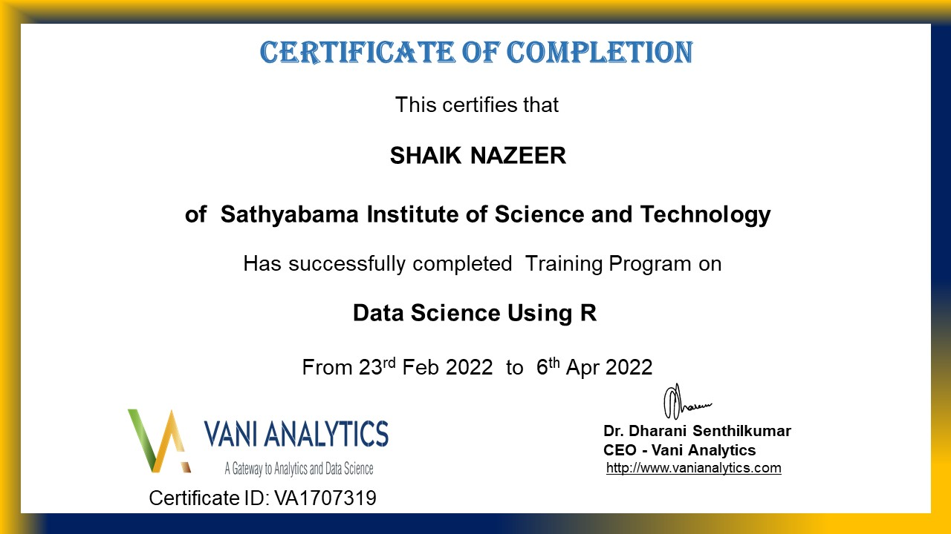
Course Certificate

Slide 4
Hardware Requirements
Processor : Processor Intel CORE i3 and above
Internet Connection : Existing telephone lines, Data card, Fiber net
RAM : 4 GB

Slide 5
Software Requirements
Operating System : Windows, Mac, Linux
Language : R Programming – R-4.1.3
GUI : RStudio

Slide 6
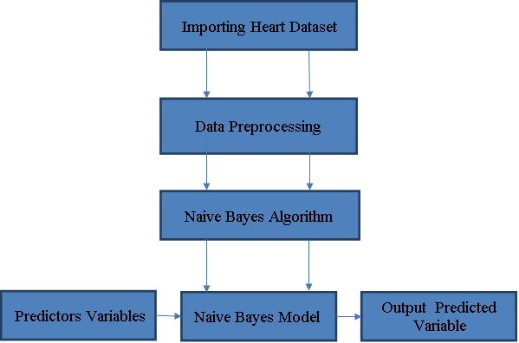
Architectural Diagram/Ideation map

Slide 7
Project Modules
There are four Modules
Importing Heart dataset
Data Preprocessing
Model Generation Using Naive Bayes Algorithm
Prediction using Naive Bayes Model

Slide 8
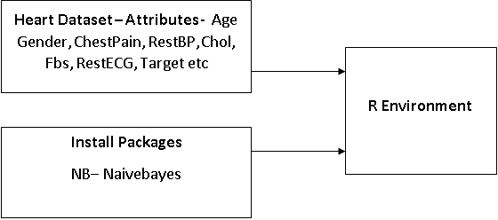
Importing Heart Dataset
Data have to be imported in to R environment for analysis.
Data can be any format like txt, .csv, .xlsx, .SPSS etc.
Package necessary for Naive Bayes algorithm have to be installed and loaded in to the program. NB – naivebayes

Slide 9
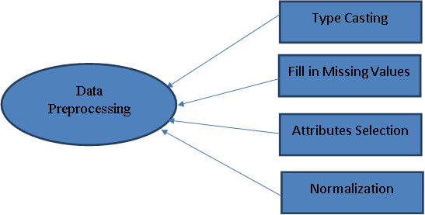
Data Preprocessing
In Data Preprocessing, it is not necessary to hold all the attributes for doing the analysis, we can hold only the attributes which is affecting the analysis

Slide 10
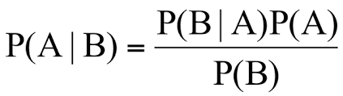
Model Generation Using Naive Bayes Algorithm
Naive Bayes is a classification and prediction algorithm based on Bayes Theorem.
Bayes Theorem

Slide 11
Model Generation Using Naive Bayes Algorithm
P(A|B) - Probability of occurrence of event A given the event B is true - Posterior Probability
P(A) - Probabilities of the occurrence of event A - Class prior Probability
P(B) - Probabilities of the occurrence of event B – Predictor Prior Probability
P(B|A) - Probability of the occurrence of event B given the event A is true - Likelihood

Slide 12
Model Generation Using Naive Bayes Algorithm
Steps in Naive Bayes algorithm
Step 1: Convert the data set into a frequency table
Step 2: Create Likelihood table by finding the probabilities
values of each attributes
Step 3: Now, use Naive Bayesian equation to calculate the posterior probability for each class. The class with the highest posterior probability is the outcome of prediction.

Slide 13
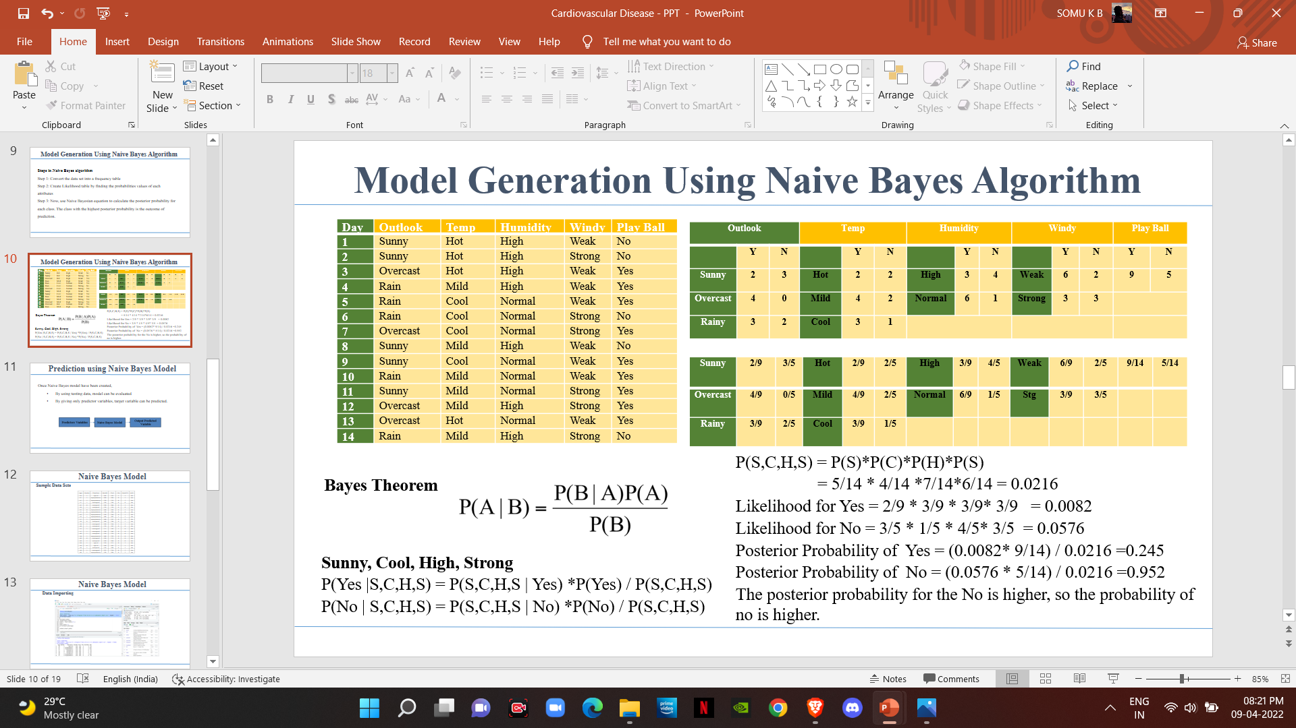
Model Generation Using Naive Bayes Algorithm

Slide 14

Prediction using Naive Bayes Model
Once Naive Bayes model have been created,
By using testing data, model can be evaluated
By giving only predictor variables, target variable can be predicted.

Slide 15
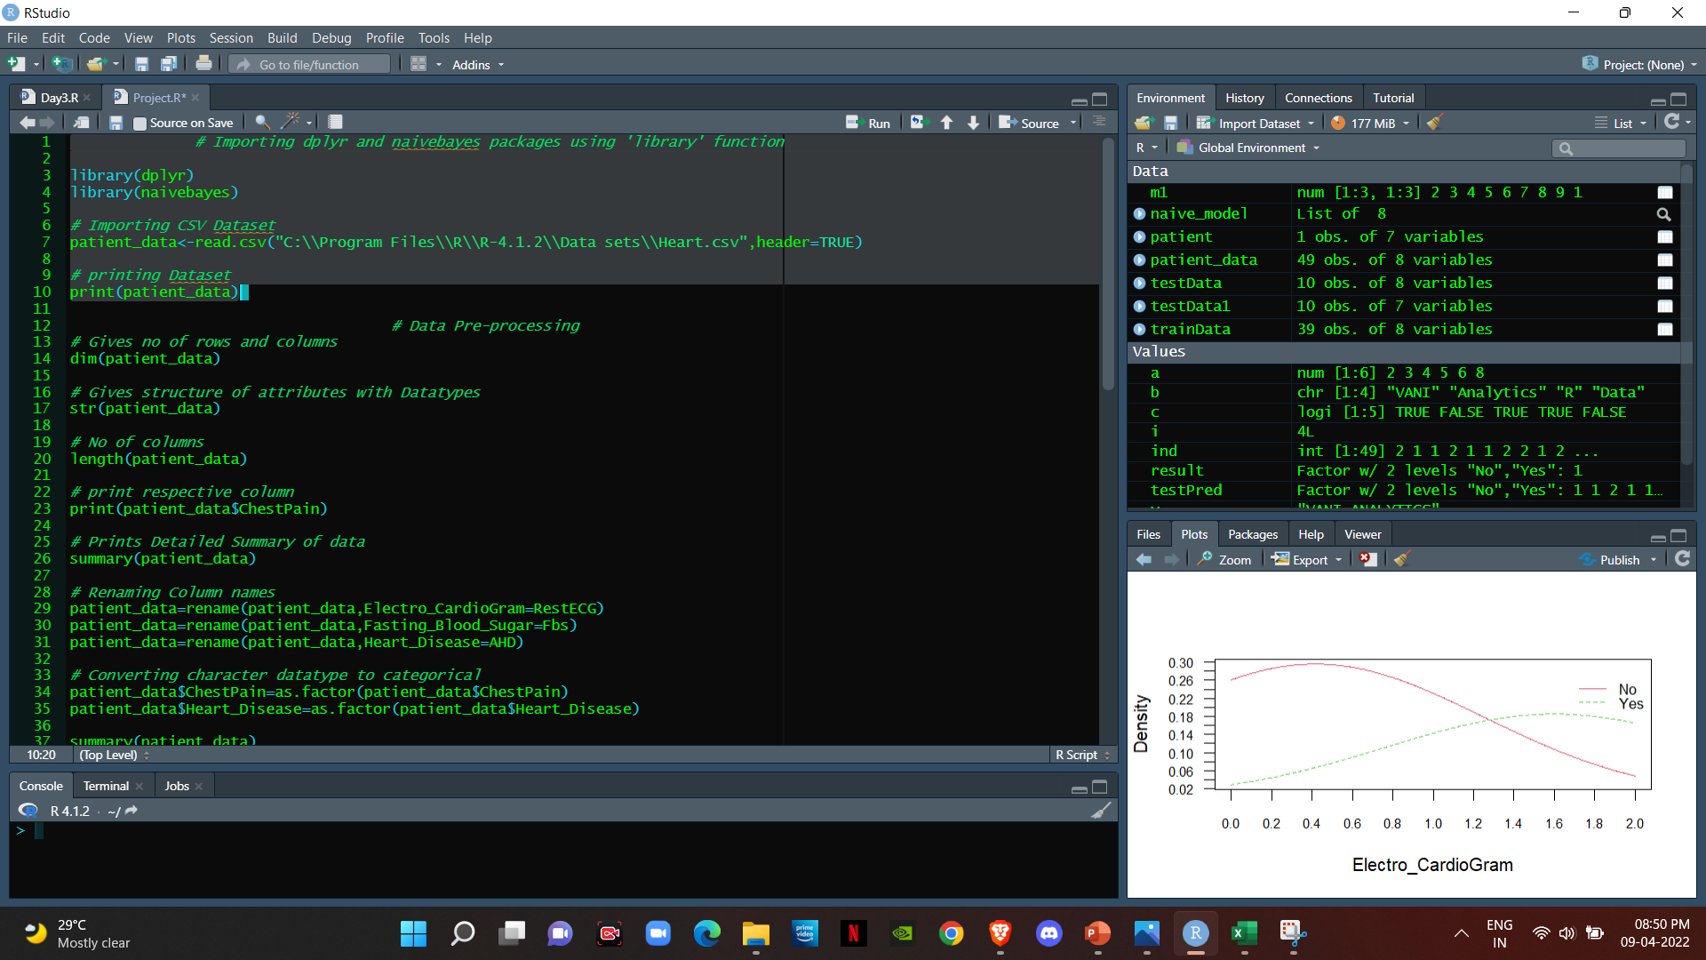
Naive Bayes Model
Data Importing

Slide 16
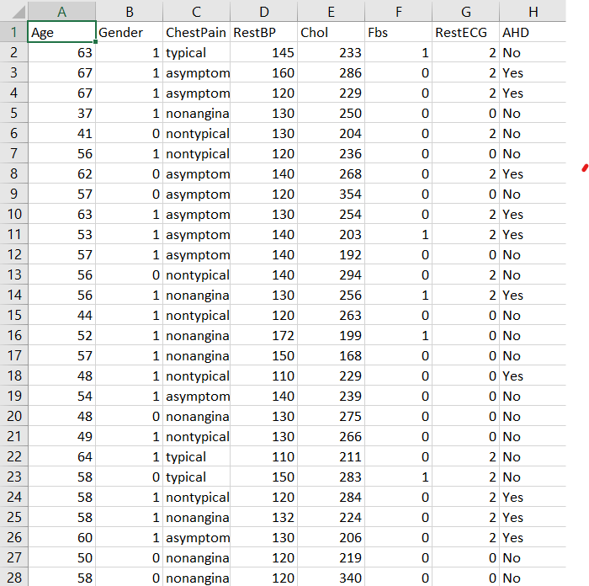
Prediction using Naive Bayes Model
Sample Data Set

Slide 17
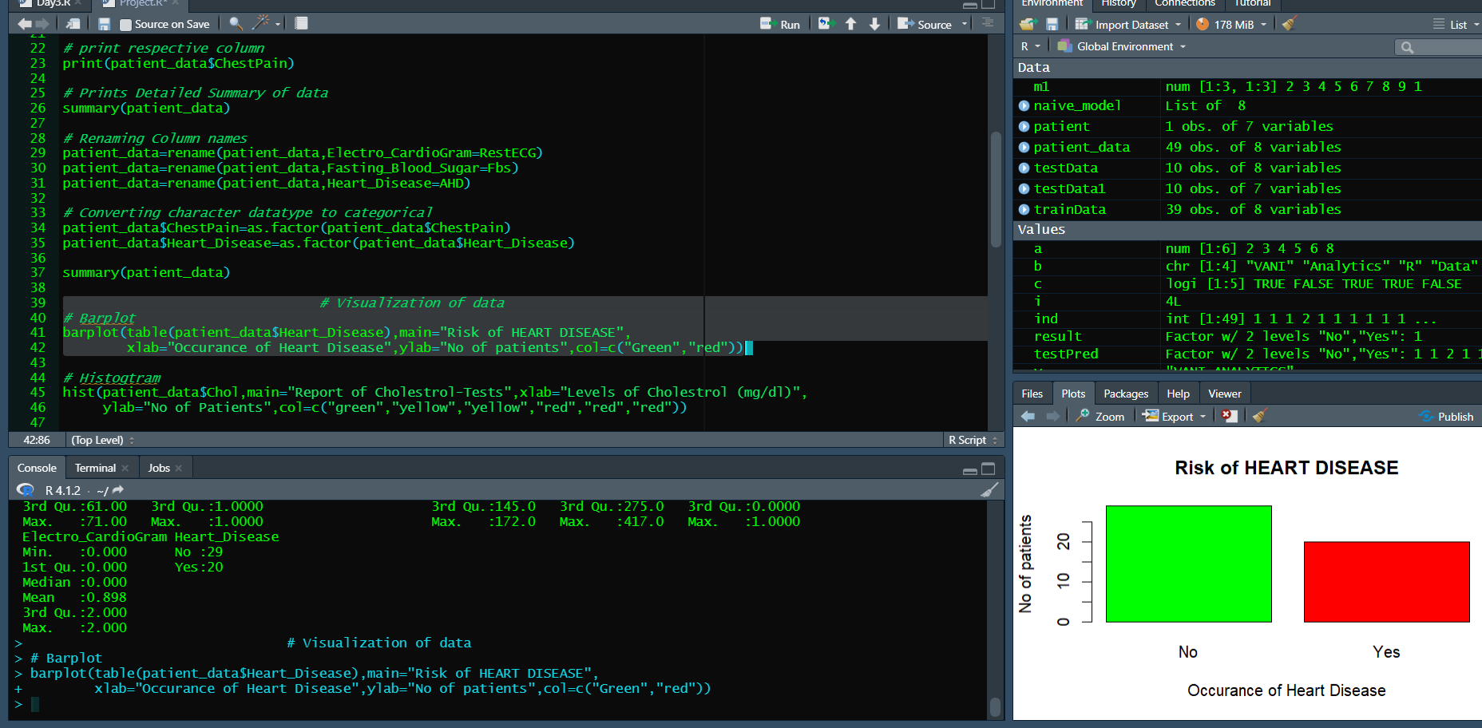
Prediction using Naive Bayes Model
Data Preprocessing

Slide 18
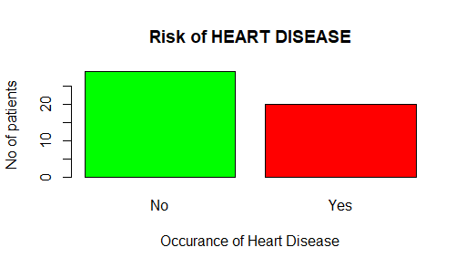
Prediction using Naive Bayes Model

Slide 19
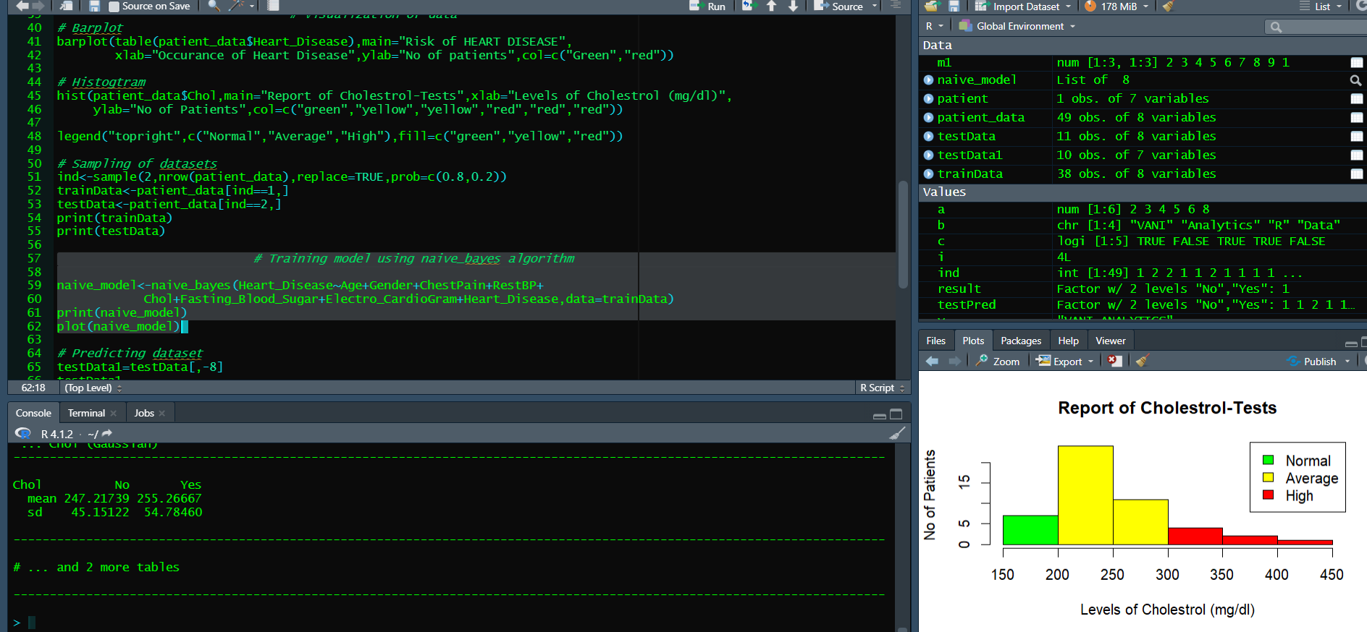
Naive Bayes Model
Naive Bayes Classification Model

Slide 20
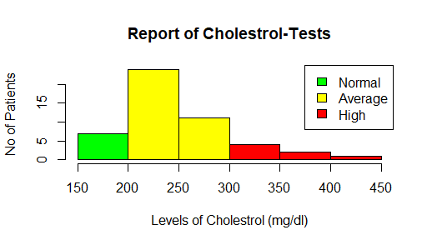
Naive Bayes Model

Slide 21
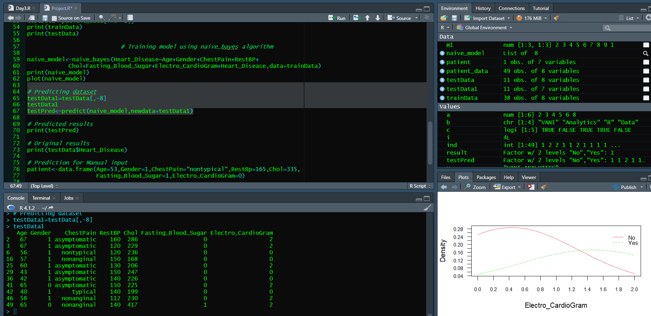
Prediction using Naive Bayes Model
Naive Bayes Classification Model

Slide 22
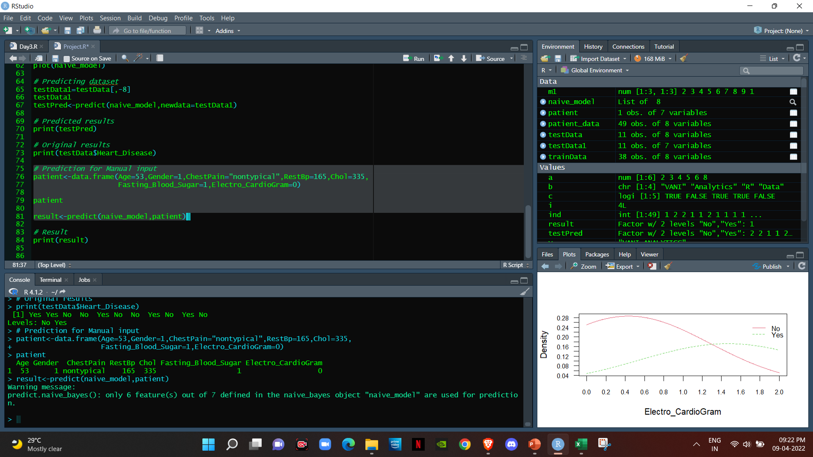
Prediction using Naive Bayes Model

Slide 23
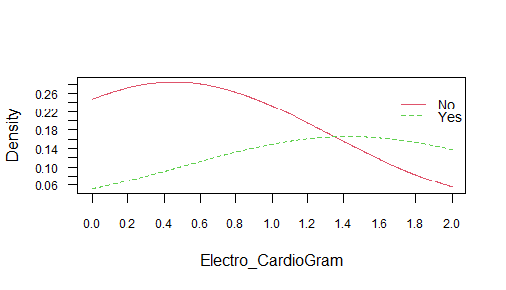
Prediction using Naive Bayes Model

Slide 24
Conclusion
This project specifies, the usage of Data Science algorithm in predicting, whether the patient is having the possibility of the heart disease. The Naive Bayes algorithm is used for predicting the patient’s heart disease using various parameters. This model can potentially help the doctors to do the prediction of heart disease in prior. Thus this project concludes, Naive Bayes Algorithm performs better and faster when compared to other statistical techniques. Thereby the diagnosis and management of heart disease can be made simpler.

Slide 25
References
1. Alperen Erdogan, Selda Guney, “Heart Disease Prediction by Using Machine Learning Algorithms", IEEE Signal Processing and Communications Applications Conference, 2020. 2. Jian Ping Li, Amin Ul Haq, Salah Ud Din, Jalaluddin Khan, ” Heart Disease Identification Method Using Machine Learning Classification in E-Healthcare”, IEEE Access,Volume: 8, 2020, pp: 107562 - 107582 3. Seyedamin Pouriyeh, “A Comprehensive Investigation and Comparison of Machine Learning Techniques in the Domain of Heart Disease ", IEEE International Conference on Computers and Communications , 2017. 4. Heart Disease Identification Method Using Machine Learning Classification in E-Healthcare, Jian Ping Li; Amin Ul Haq; Salah Ud Din; Jalaluddin Khan;Asif Khan;Abdus Saboor,IEEE Access, 2020, Volume: 8. 5. An Automated Strategy for Early Risk Identification of Sudden Cardiac Death by Using Machine Learning Approach on Measurable Arrhythmic Risk Markers”,Dakun Lai;Yifei Zhang;Xinshu Zhang;Ye Su;Md Belal Bin Heyat, IEEE Access, Year: 2019, Vol. 7.

Slide 26
THANK YOU

